Slide 1

Summer Undergraduate Research Award 2024
Shear Thickening Fluids
Prediction of viscosity of Non-Newtonian fluids at different shear rates and temperatures using artificial neural network models
Applicant: Lakshya Kumar (2022TT12183)
Abhiraj Kumar Koslia (2022TT12187)
Department: Dept. of Textile & Fibre Engg.
Facilitator: Prof. Abhijit Majumdar
Department: Dept. of Textile & Fibre Engg.
Notes:
good afternoon everyone, i’m ks from dbeb. Today, I shall be presenting my SURA project titled: , under prof tn, of the ksbs dept

Slide 2
Table Of Contents
1
Introduction
2
Objectives
3
Methodology
4
Future Scope
5
Timeline
6
Budget
7
Conclusion

Slide 3
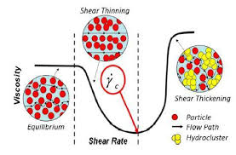
01.
Initially, ballistic textiles relied solely on high-performance fibers, such as aramids (e.g., Kevlar) and ultra-high molecular weight polyethylene (UHMWPE), to provide protection against impact threats. While these fibers offer exceptional strength and stiffness, their performance in dissipating the kinetic energy of projectiles or impacts was limited.
To enhance the impact resistance and energy dissipation capabilities of ballistic textiles, researchers explored the integration of shear thickening fluids (STFs) with these high-performance fiber fabrics.
Introduction
Schematics of Shear Thinning and Shear Thickening Effect

Slide 4
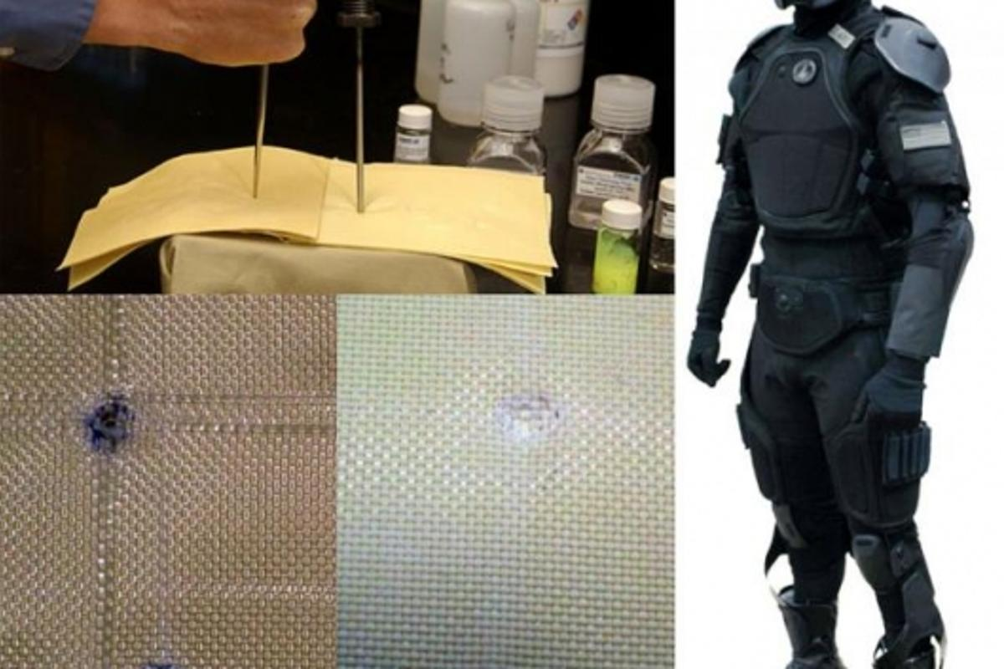
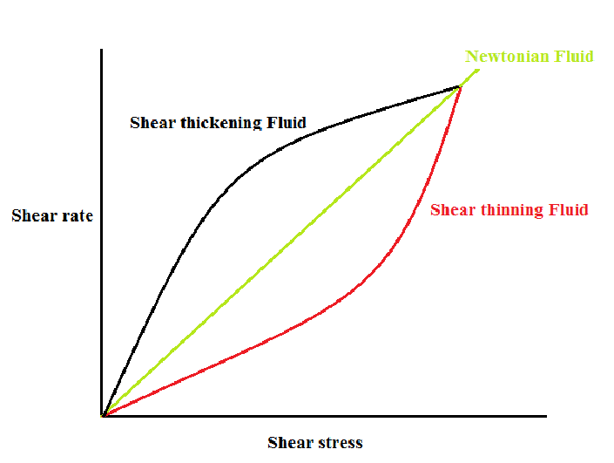
02.
The main objective of our project is to analyze the changes in viscosity of a non-Newtonian fluid due to changing parameters such as particle size and temperature.
Synthesis of Shear Thickening Fluids (STFs)
Perform rheological studies on the prepared STFs
Data Driven Insights can be taken by analyzing the data collected and building a predictive model using curve-fitting techniques and artificial neural networks.
Identify and implement suitable changes to current models to address their shortcomings on the given dataset by evaluating several configurations of the networks.
Objectives
(self generated)

Slide 5
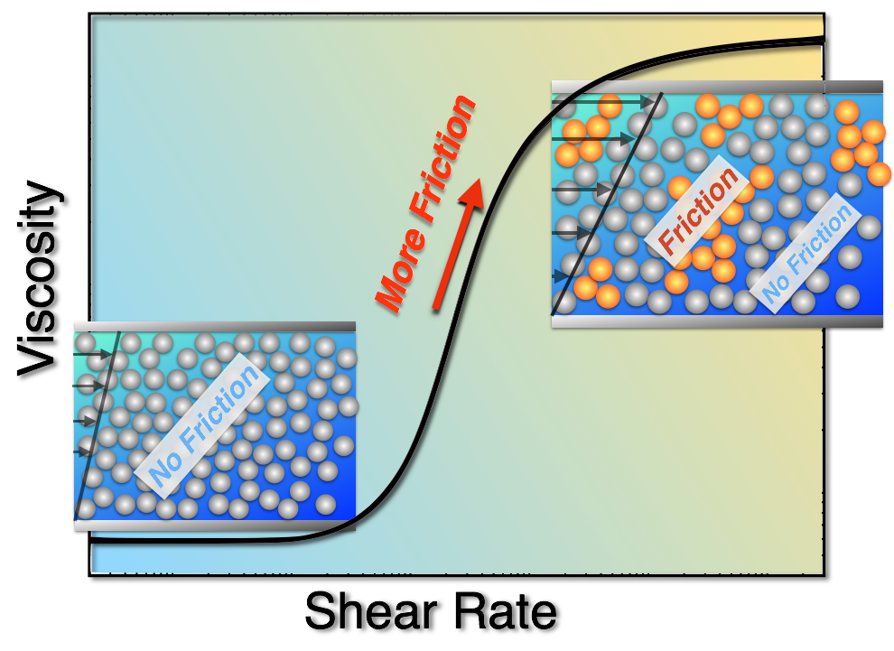
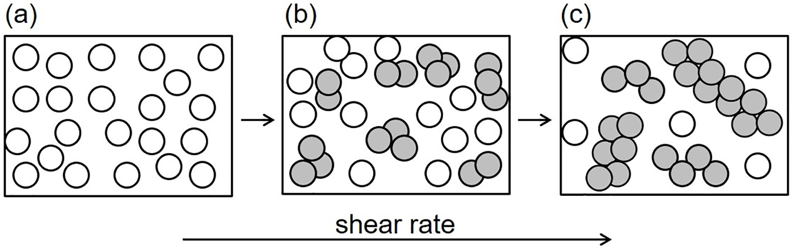
What are STFs?
This remarkable property arises from the formation of hydro clusters or jamming clusters of particles suspended in the fluid, which resist flow under high shear. STFs have garnered significant interest due to their potential applications in developing impact-resistant materials, such as body armor, protective gear, and energy-dissipating systems.
Shear thickening fluids (STFs) are a unique class of non-Newtonian fluids that exhibit an extraordinary transition from liquid-like to solid-like behavior when subjected to high shear rates or impact forces.
Notes:
shizao severe mental disorder
24 million people globally
on top of battling disorder, face social stigma and ridiculous expenses on treatments which are often ineffective, this causes them to feel like a burden and they attempt suicide in alarming no.s
+: delusions and hallucinations
-: apathy, lack of interest

Slide 6
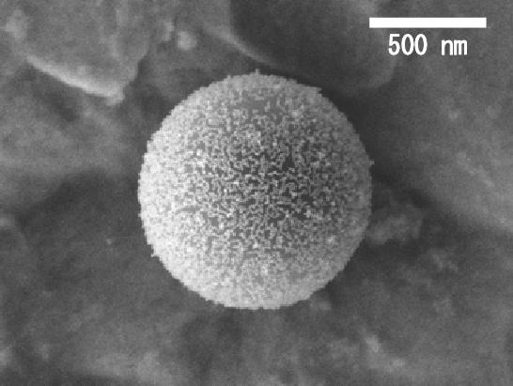
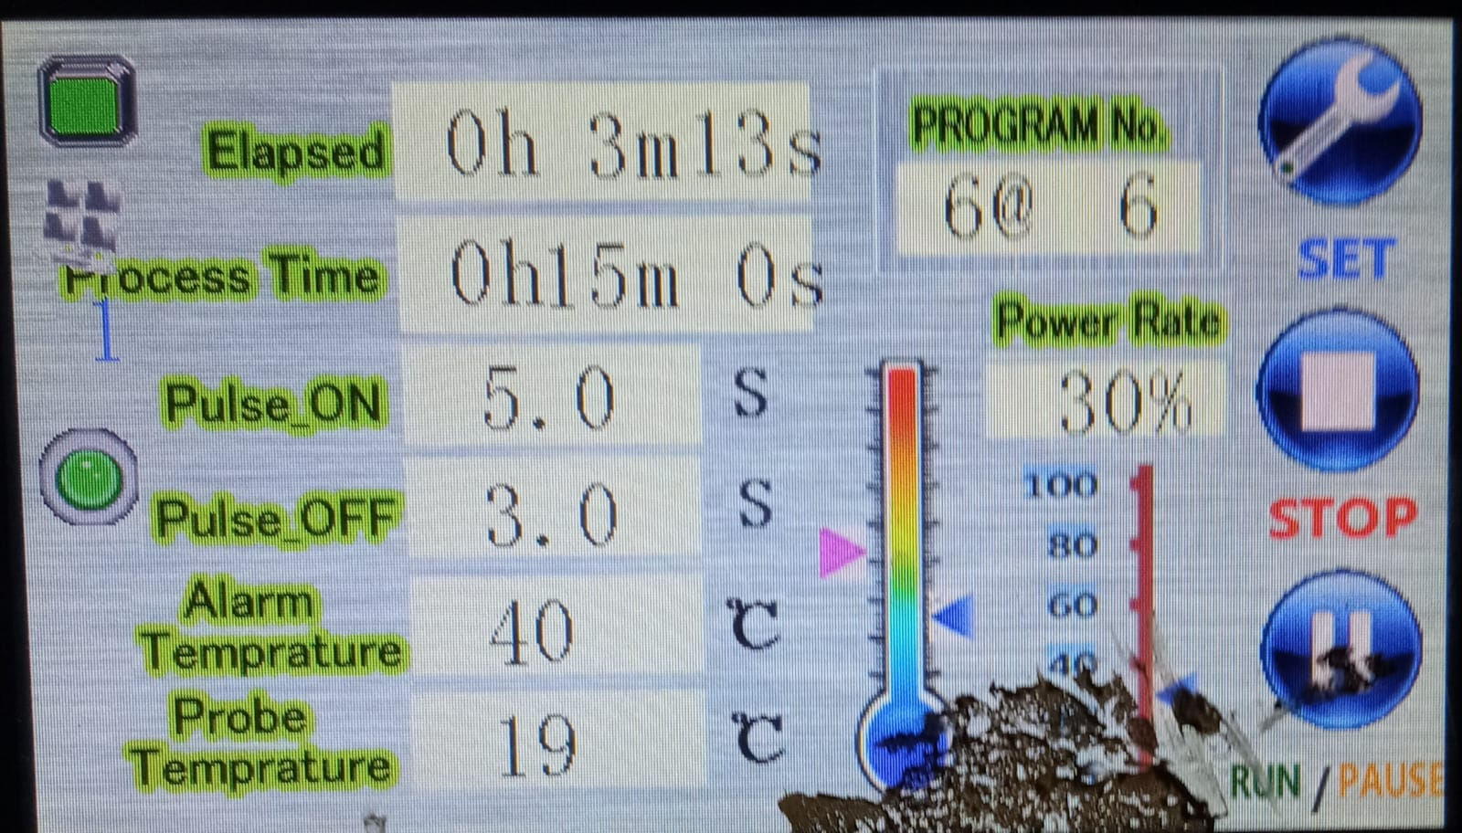
03.
Methodology

Slide 7
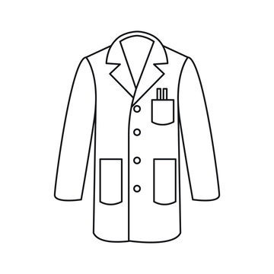
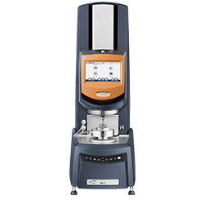
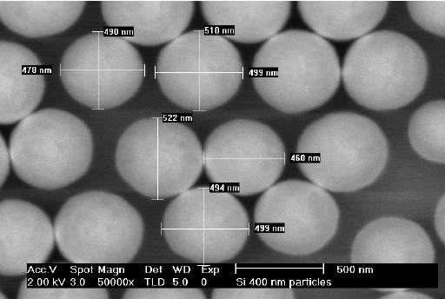




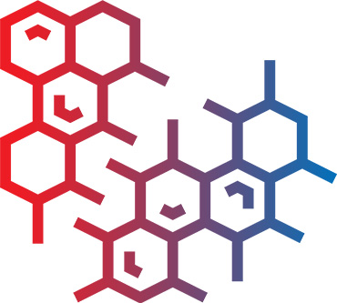
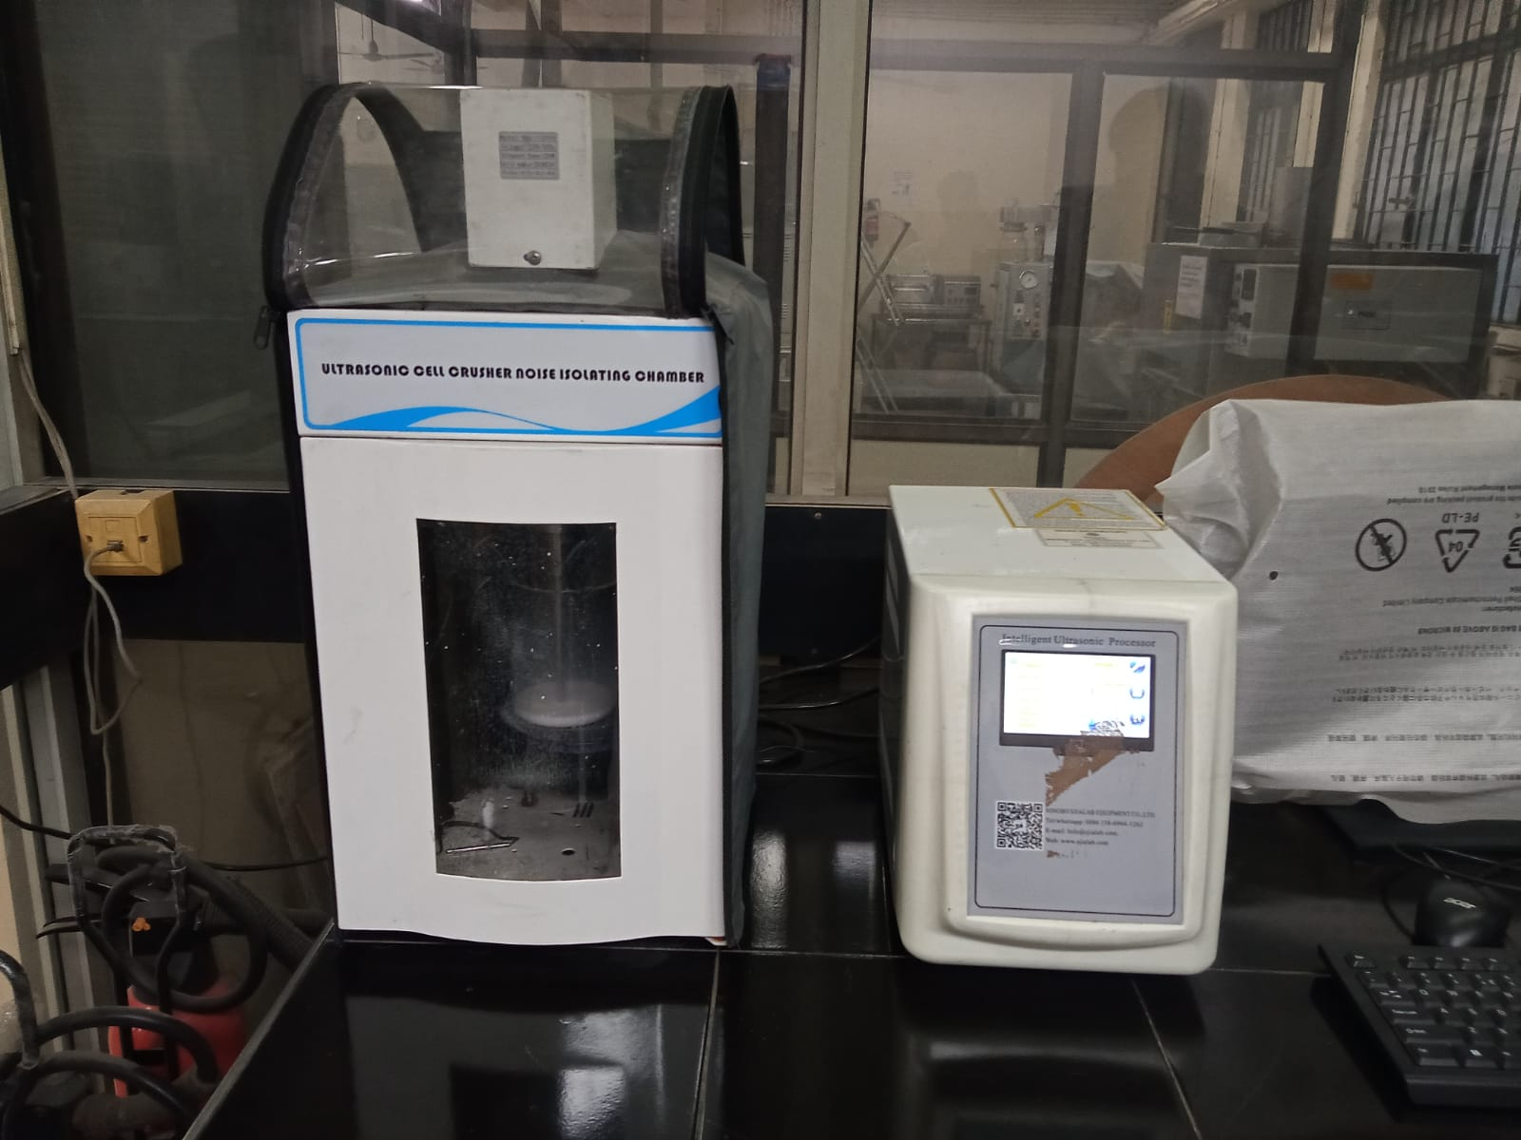
Experimental aspect:
3.1 Experimental Design
3.2 Sample Preparation
Prepare Sample
Rheological Testing
Equipment Needed
Mixture allowed to rest in Oven
Weigh and Measure
Disperse in the PEG
Ultrasonicator to ensure proper mixing
Notes:
properties of and the interplay between the various neurotransmitter systems involved
morphology of the neurons involved
kinetics of the receptors, along with their unique mech
parameters such as the density and location of receptors expressed on the surface of the neuron

Slide 8
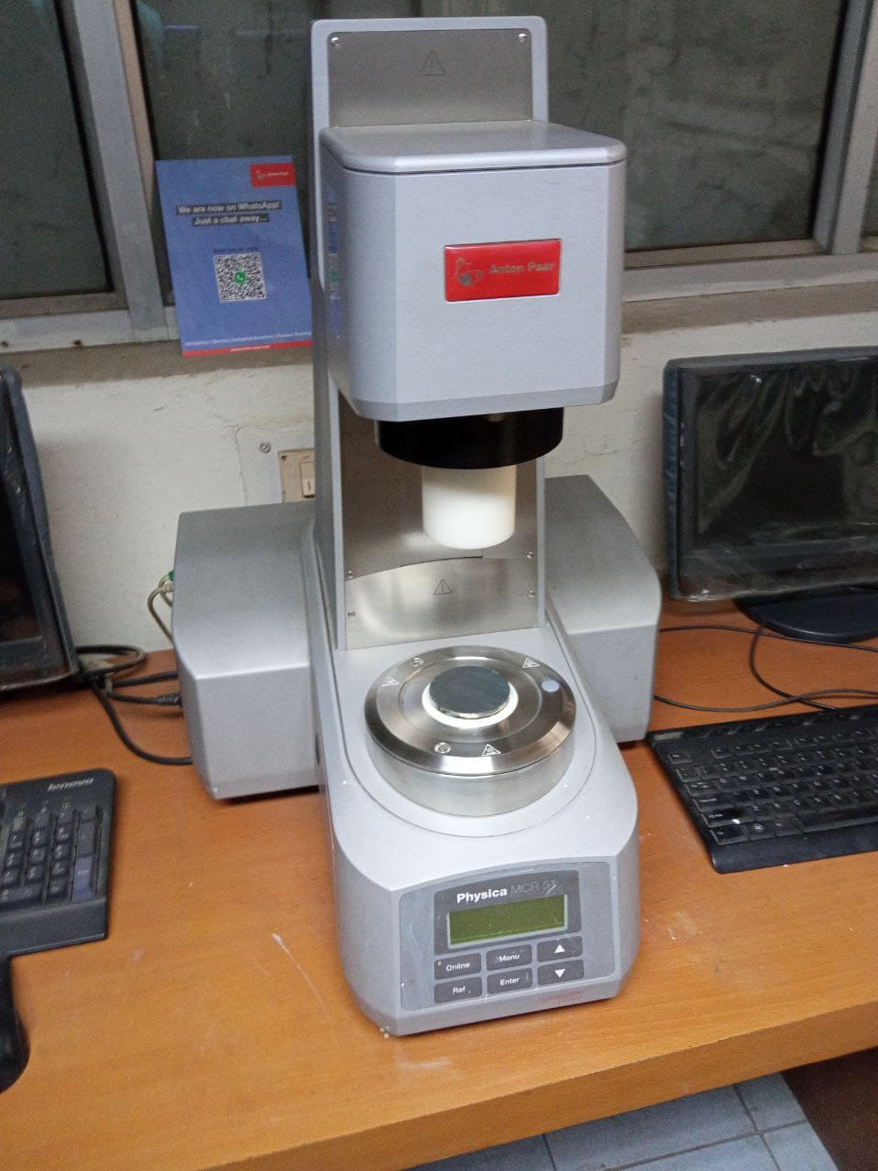
3.3 Rheology Testing
Using the prepared samples, we will conduct rheology testing on the rheometer.
Viscosity measurements will be taken at various shear rates (controlled by the rheometer settings) at the specified temperatures.
Data collected will include shear rate, temperature, and the corresponding viscosity values for each sample.
3.4 Data Collection
The viscosity data obtained from the rheology tests will serve as the training dataset for the artificial neural network models.
Each data point will consist of:
Input: Shear rate, temperature, nanoparticle size
Output: Viscosity

Slide 9

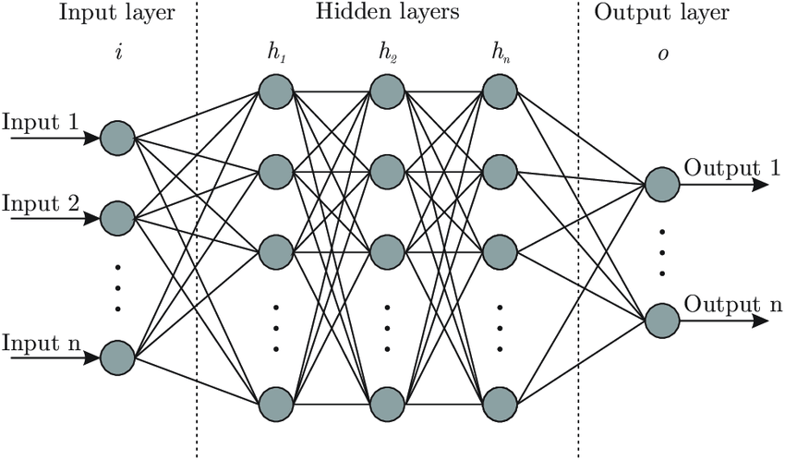

Computational aspect:
3.5 Artificial Neural Network (ANN) Model Development
We will design an ANN model using software like TensorFlow or PyTorch.
The input layer will have nodes for shear rate, temperature, and nanoparticle size.
The output layer will predict the viscosity.

Slide 10


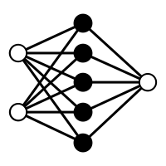
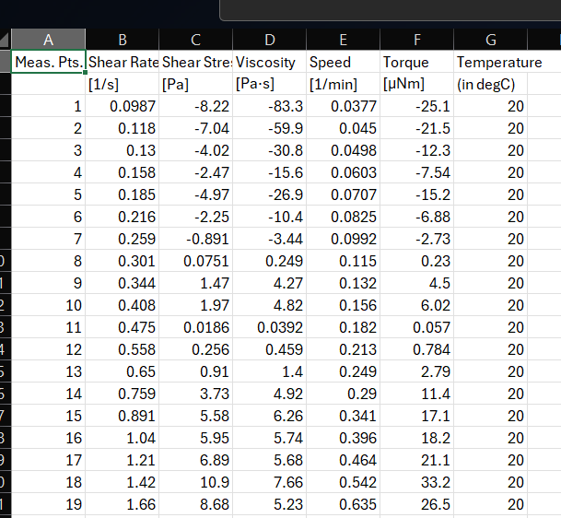

3.6 Model Evaluation
Prediction of Test Dataset
Model
TEST DATASET
Optimisation of Code and minimizing error

Slide 11
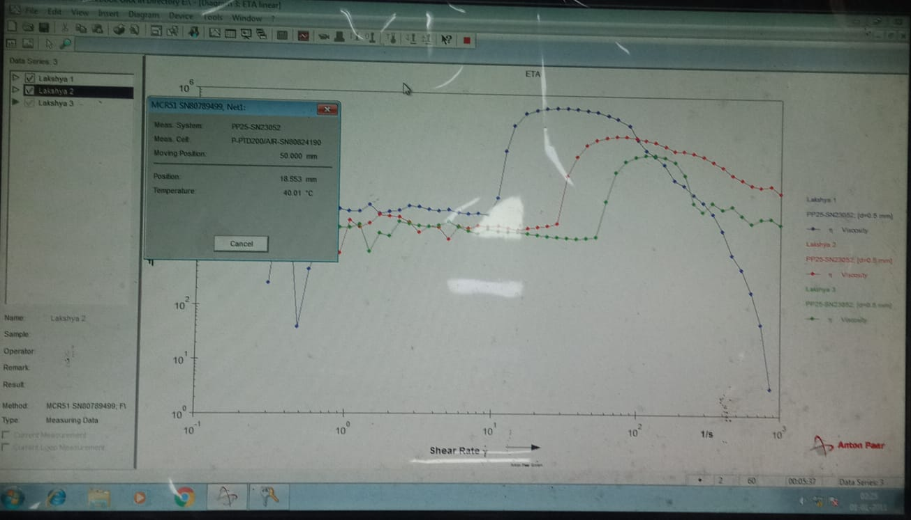
3.7 Prediction & Analysis of Viscosity
With a trained and validated ANN model, we will input new data (shear rate, temperature, nanoparticle size) to predict viscosity.
The model will output the estimated viscosity values for the given conditions.
We will analyze the predicted viscosity values and compare them to actual measurements to validate the model's accuracy.
Any discrepancies will be investigated to improve the model if necessary.
This approach aims to utilize experimental data to train an ANN model that can effectively predict the viscosity of Non-Newtonian fluids under varying conditions. It involves careful sample preparation, thorough rheology testing, model development, training, validation, and evaluation to ensure reliable predictions.

Slide 12
04.
Protective equipment: STFs can be integrated into fabrics for ballistic testing and understanding their applications like anti-stab armor and shin guards, where their shear thickening behavior enhances impact and penetration resistance.
Investigating the temperature dependence of STF rheology is crucial as it can guide the selection of appropriate particle concentration and size for specific applications across different environmental conditions.
Motion sensors and lithium battery electrolytes: STFs have been explored as motion sensors due to their viscosity changes in response to applied forces, and as potential electrolytes in lithium-ion batteries to enhance safety and performance.
Vibration damping and impact absorption: The energy dissipation capabilities of STFs make them suitable for use as buffer materials in vibration damping and impact absorption applications.
Future Scope

Slide 13
06.
Experimental aspect
Sample Preparations
Rheology Testing
Data Gathering
1st Month
Literature review
Vary parameters
Record observations
Collect data
Computational aspect
Build Model
Train Model
Efficiency Testing
2nd Month
Literature review
Build primary model
Train on training set
Check efficiency using testing dataset.
Timeline

Slide 14
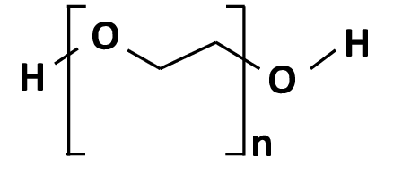

7.
The duration of the project will be 2 months. The flowchart gives a rough estimate of timeline. We will continue to work beyond this projected timeline if required to bring the project to a meaningful conclusion.
We will require access to the following resources for the project:
1. Silica Particles of sizes : - 100 nm - 300 nm - 500 nm
2. Polyethylene glycol (PEG) of 200 mol. wt.
3. Ethanol
4. Equipments : - Homogenizer - Ultrasonicator - Rheometer - Oven - General lab equipments like gloves, beakers, stirrers etc
We will need approximately Rs. 25,000 and high priority access to above mentioned resources present in the laboratories.
Budget

Slide 15
05.
In conclusion, in my project on shear thickening fluids (STFs), I shall investigate the role of particle size and temperature on the viscosity behavior of these non-Newtonian fluids. I will synthesize STF samples using silica nanoparticles of different sizes (100 nm, 300 nm, and 500 nm) and conduct rheological studies to measure the viscosity changes under varying shear rates and temperatures (10°C, 20°C, and 30°C). Using the experimental data, I will develop an artificial neural network (ANN) model to predict the viscosity of STFs based on input parameters such as shear rate, temperature, and particle size. Through this computational (ANN) and experimental (rheology) approach, I aim to gain insights into the complex viscosity behavior of STFs and understand the impact of particle size and temperature on their shear thickening phenomenon. This understanding will facilitate the effective utilization of STFs in various applications, including impact-resistant materials, protective gear, energy dissipation systems, and motion sensors.
Conclusion

Slide 16
References
F.J. Galindo-Rosales,F.J. Rubio-Hernández, and A. Sevilla, (2011) ‘An apparent viscosity function for shear thickening fluids’, Journal of Non-Newtonian Fluid Mechanics, 166(5–6), pp. 321–325. doi:10.1016/j.jnnfm.2011.01.001.
Mohammad Hemmat Esfe,Seyfolah Saedodin,Nima Sina,Masoud Afrand,Sara Rostami, (2015) ‘Designing an artificial neural network to predict thermal conductivity and dynamic viscosity of ferromagnetic nanofluid’, International Communications in Heat and Mass Transfer, 68, pp. 50–57. doi:10.1016/j.icheatmasstransfer.2015.06.013.
Marziyeh Ramzi , Mahdi Kashaninejad , Fakhreddin Salehi , Ali Reza Sadeghi Mahoonak, Seyed Mohammad Ali Razavi (2015) ‘Modeling of rheological behavior of honey using genetic algorithm–artificial neural network and adaptive neuro-fuzzy inference system’, Food Bioscience, 9, pp. 60–67. doi:10.1016/j.fbio.2014.12.001.
Zarei, M. and Aalaie, J. (2020) ‘Application of shear thickening fluids in material development’, Journal of Materials Research and Technology, 9(5), pp. 10411–10433. doi:10.1016/j.jmrt.2020.07.049.
Sanchi Arora, Animesh Laha, Abhijit Majumdar and Bhupendra Singh Butola (2017) ‘Prediction of rheology of shear thickening fluids using phenomenological and artificial neural network models’, Korea-Australia Rheology Journal, 29(3), pp. 185–193. doi:10.1007/s13367-017-0019-x.

Slide 17
THANK
YOU!

